Slide 1


Utilizing unused renewable energy

Slide 2
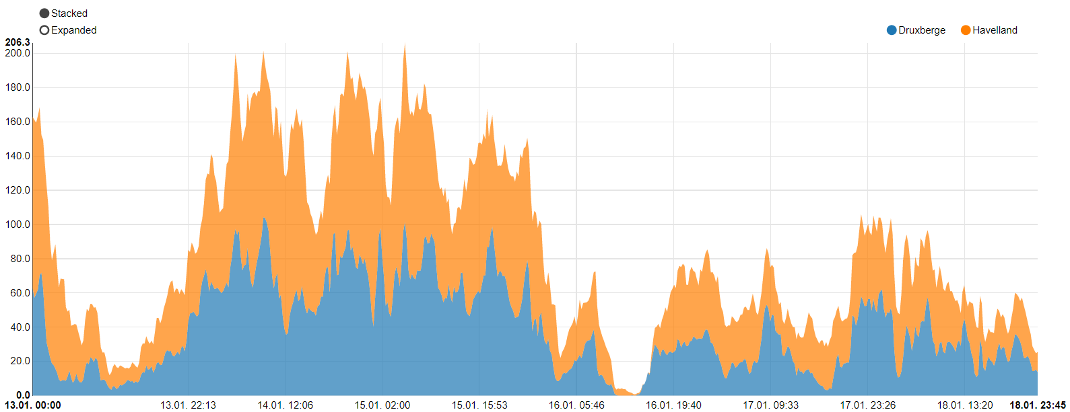

Problem
Power production is inconsistent
Mismatch in Power production and demand
Excess energy is stored
Power (MWh)
Figure 1: Peaks and troughs of onshore wind power plants in Germany
Source: https://www.energy-charts.de/power.htm?source=wind-onshore&year=2020&week=3
Rocket Science // Moritz, Kai, Annabelle, Lennart, Christian

Slide 3
Energy storage systems
Possible solution?
Which system fits best?
Vehicle to grid
Power-to-Gas
Hydrogen
Excess energy
Battery storage system
Pumped storage hydropower
Rocket Science // Moritz, Kai, Annabelle, Lennart, Christian

Slide 4
Framework
Cost
Efficiency
Safety
Scalability
Technical Feasibility

Slide 5
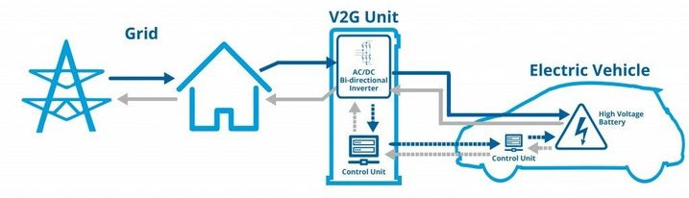
Vehicle to grid
Source:
https://www.zhaw.ch/de/engineering/institute-zentren/ine/smart-city-leitfaden/uebersicht-anwendungsbeispiele/vehicle-to-grid-v2g/
Rocket Science // Moritz, Kai, Annabelle, Lennart, Christian

Slide 6
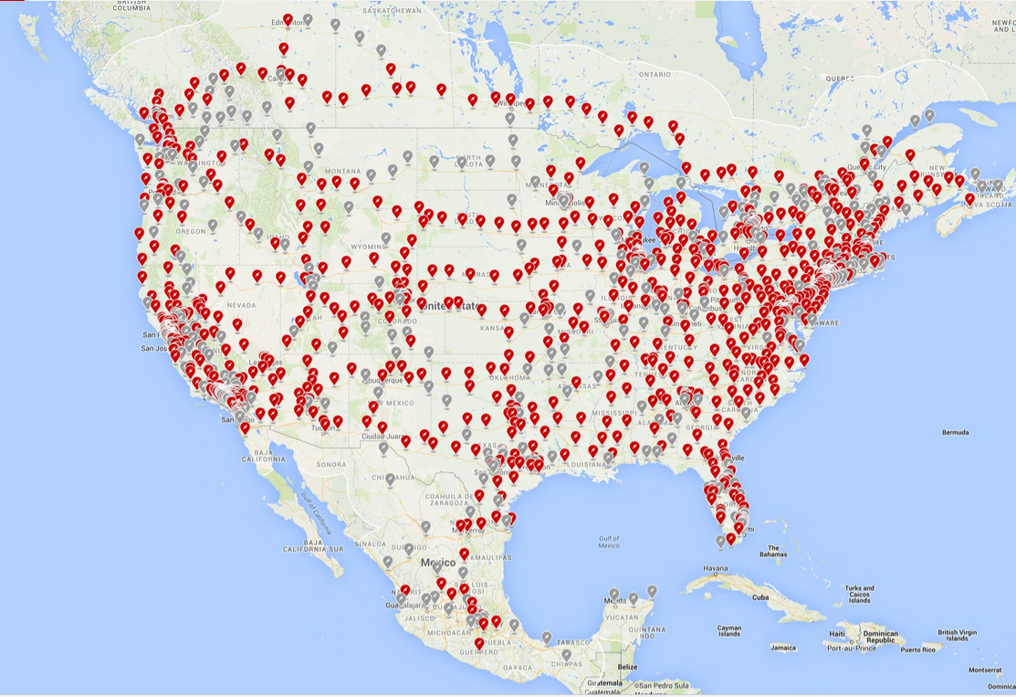
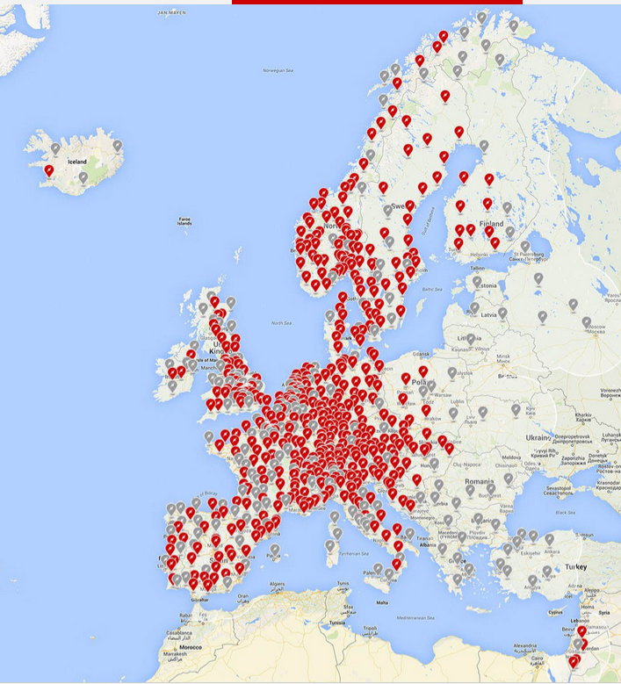
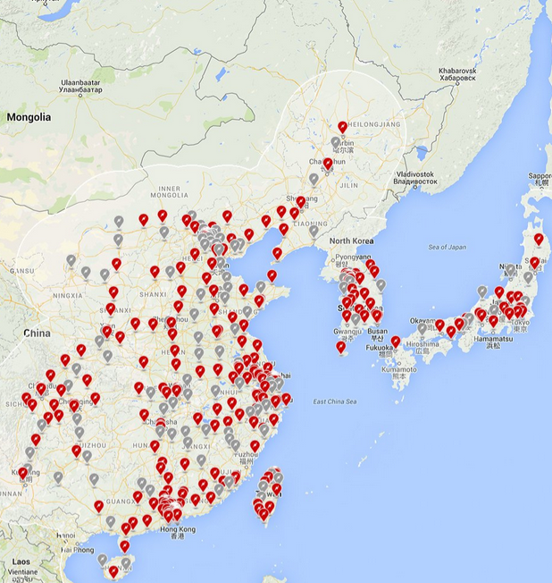
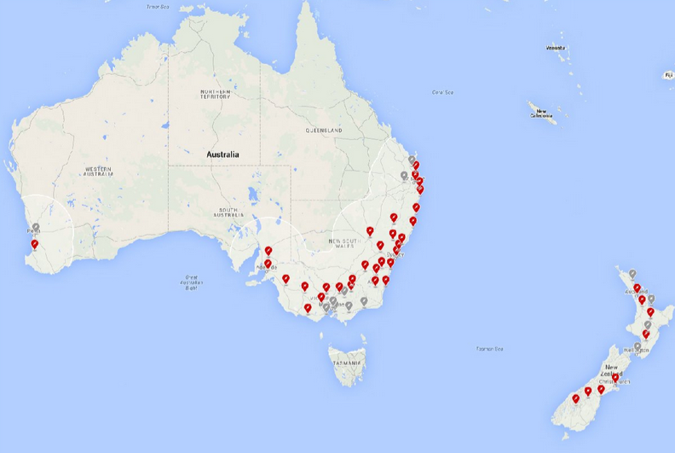
Vehicle to grid
Source: https://www.tesla.com/de_DE/supercharger
Rocket Science // Moritz, Kai, Annabelle, Lennart, Christian

Slide 7
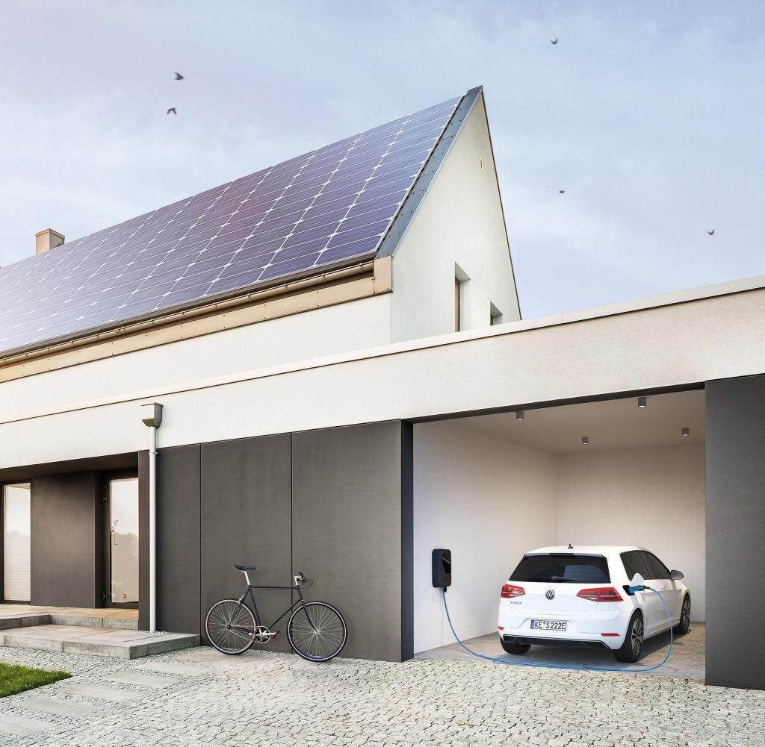
Vehicle to grid
Sofurce: https://www.welt.de/wirtschaft/plus203191334/E-Auto-Solaranlage-Stromspeicher-So-gut-ist-die-340-Euro-Flatrate.html
Rocket Science // Moritz, Kai, Annabelle, Lennart, Christian

Slide 8
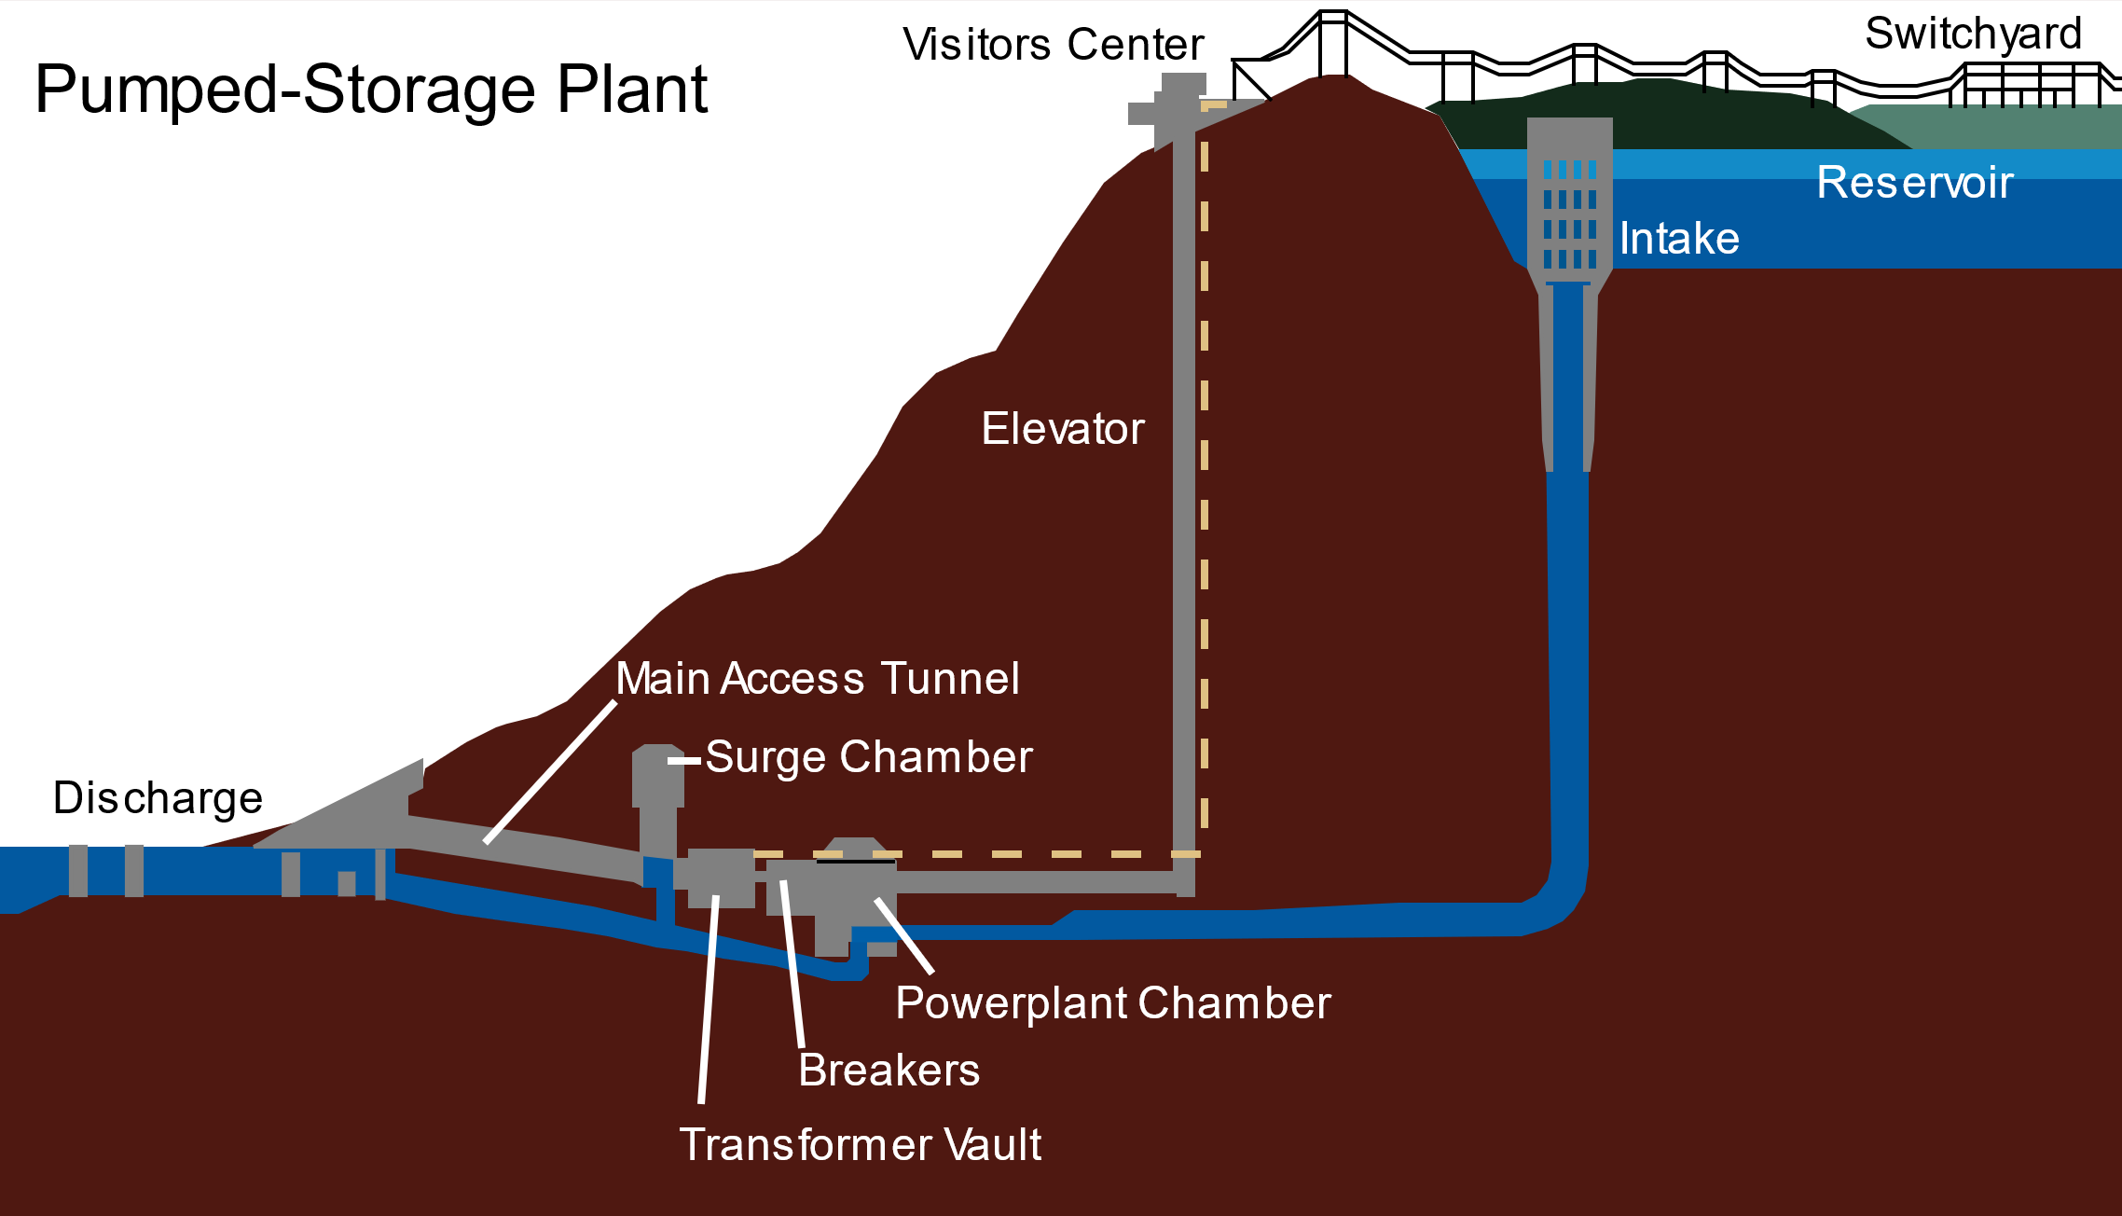
Pumped storage hydropower
Source: https://en.wikipedia.org/wiki/Pumped-storage_hydroelectricity
Rocket Science // Moritz, Kai, Annabelle, Lennart, Christian

Slide 9
Pumped storage hydropower
Lifecycle 20 to 50 years
Disadvantages
Geographical restraints
Advantages
Fulfills cost-criteria
Scalable to high capacities

Slide 10
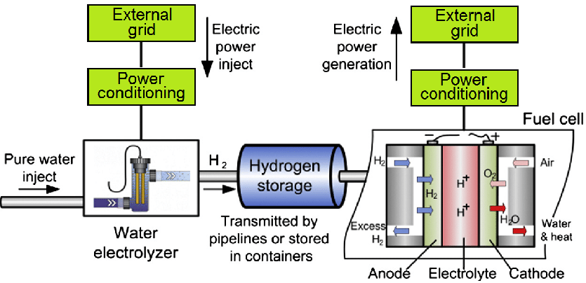
Hydrogen as an energy storage system
Source:https://www.researchgate.net/figure/Topology-of-hydrogen-storage-system-electrolyser-storage-vessel-and-fuel-cell-after_fig1_311679888
Rocket Science // Moritz, Kai, Annabelle, Lennart, Christian

Slide 11
Hydrogen as an energy storage system
Lifecycle: 30 to 45 years
45% round-trip efficiency
Disadvantages
Expensive
Inefficient
Advantages
Power and Energy are independtly scalable
Hydrogen production enables further usage

Slide 12
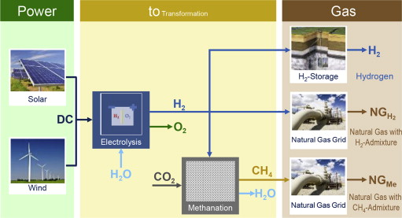
Power-to-Gas
Source: https://www.sciencedirect.com/science/article/abs/pii/S0360319915001913
Rocket Science // Moritz, Kai, Annabelle, Lennart, Christian

Slide 13
Power-to-Gas
Lifecycle: 5 to 10 years
Around 70% efficiency
Disadvantages
Expensive
Lack of infrastructure
Advantages
Easy scalable
Diverse uses of Hydrogen
Relatively high efficiency

Slide 14
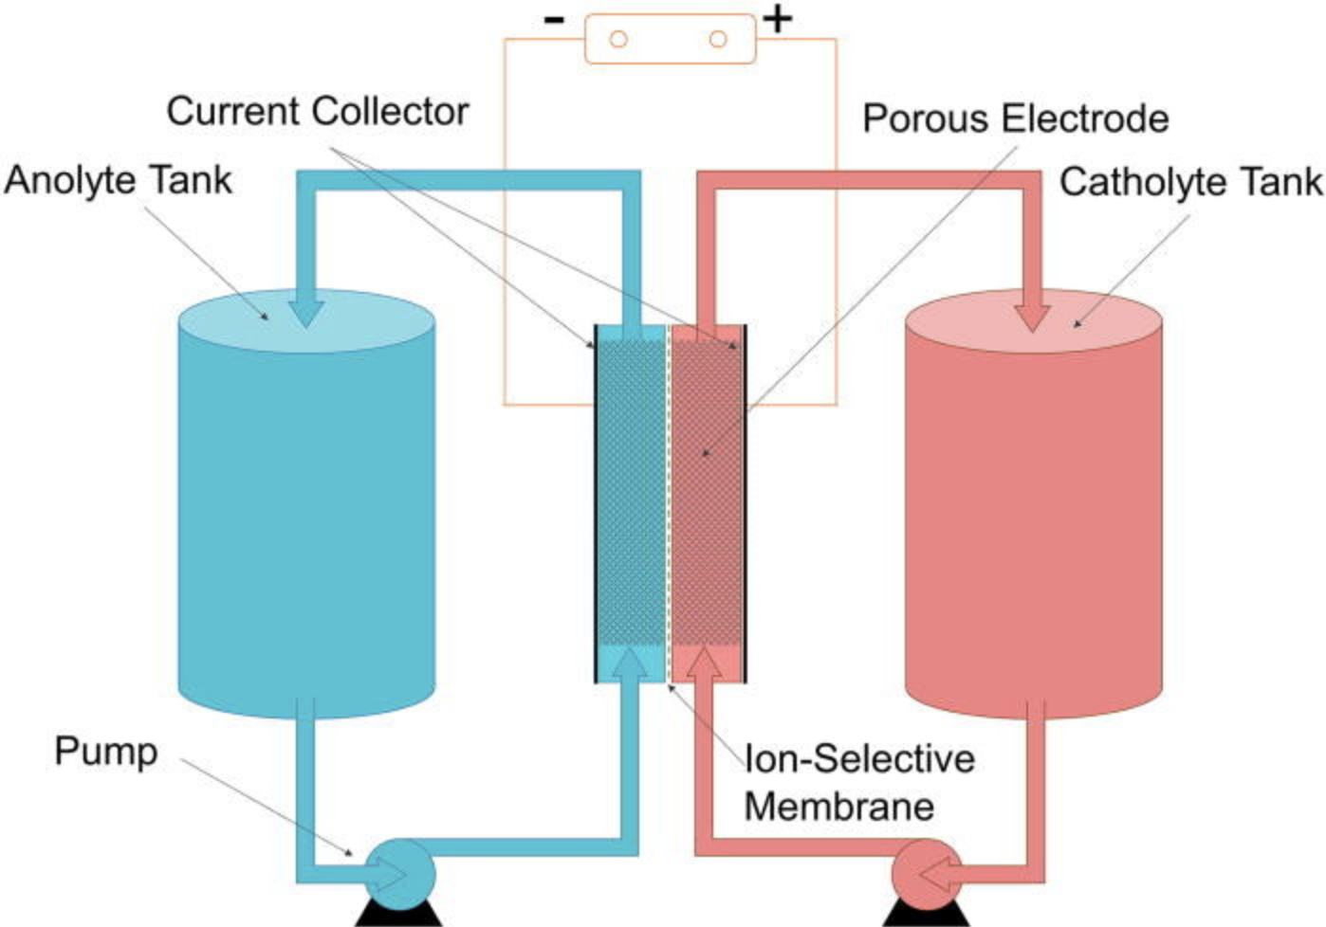
Batteries
Vanadium Redox Flow Battery
Source: https://en.wikipedia.org/wiki/Vanadium_redox_battery#/media/File:Redox_Flow_Battery.jpg
Rocket Science // Moritz, Kai, Annabelle, Lennart, Christian

Slide 15
Vanadium Redox Flow Battery
12,000-20,000 cycle life (90% capacity drop)
330 - 970 €/kWh
75% efficiency
Disadvantages
Toxic chemicals
Early stage in development
Advantages
Power and energy are separated
Discharge up to 20h

Slide 16
Comparison
Criteria
 | Cost | Efficiency | Safety | Scaling | Technical feasibility
Vehicle to grid | - - - | + | + + + | - - | - - -
Pumped storage hydropower | + | + + + | + + | + + | - -
Hydrogen | - - | - - - | + + | + + + | + + +
Power-to-Gas | - - | + | + + | + + + | + + +
Batteries | + + + | + + | + + | + + + | + +
Systems
Table 1: Comparison between energy storage systems
Rocket Science // Moritz, Kai, Annabelle, Lennart, Christian

Slide 17
Comparison
Criteria
 | Cost | Efficiency | Safety | Scaling | Technical feasibility | Total
Vehicle to grid | - - - | + | + + + | - - | - - - | -18
Pumped storage hydropower | + | + + + | + + | + + | - - | +6
Hydrogen | - - | - - - | + + | + + + | + + + | +8
Power-to-Gas | - - | + | + + | + + + | + + + | +12
Batteries | + + + | + + | + + | + + + | + + | +25
Systems
Table 1: Comparison between energy storage systems
Rocket Science // Moritz, Kai, Annabelle, Lennart, Christian

Slide 18

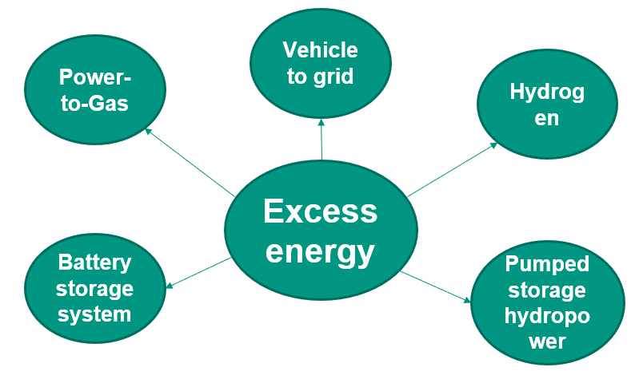
Conclusion
Various technologies are technically feasible and scalable
Overall best solution → Battery storage
Rocket Science // Moritz, Kai, Annabelle, Lennart, Christian

Slide 19
Recommendations
Construction of Battery Storage Facilities as soon as possible
Best current solution
Rapid developments in Hydrogen usage and infratructure could substitute Batteries in the future
Rocket Science // Moritz, Kai, Annabelle, Lennart, Christian

